Slide 1
Array

Slide 2
What is array
Linear structure of the data elements in the memory.
Can contain only similar data elements in the memory.
Arrays are among the oldest and most important data structures, and are used by almost every program.
Arrays are useful mostly because the element indices can be computed at run time. Among other things, this feature allows a single iterative statement to process arbitrarily many elements of an array.
Declaration of the array:
Data type Array Name[ Size of the array];

Slide 3
Operations can be performed
Traversing
Searching- linear n binary
Insertion start middle and end
Deletion

Slide 4
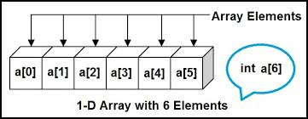
Single/One Dimensional Array
A one-dimensional array (or single dimension array) is a type of linear array.
Its elements involves a single subscript which can either represent a row or column index.

Slide 5
Linear Array:
A linear array is a list of finite number of homogeneous data elements (same data type)
Length of the array is : upper bound-lower bound+1.
Representation of Linear Array in memory
LOC(LA[K]=address of the element LA[K] of the array LA.
LOC(LA[K]=Base(LA)+w(K-lower bound).

Slide 6
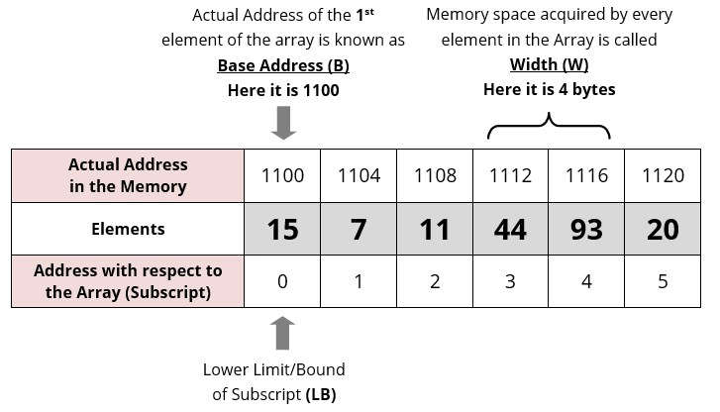

Slide 7
Q1. Data[] is an array that is declared as intData[20]; and contains the following
values:
Data[] = {12, 23, 34, 45, 56, 67, 78, 89, 90, 100};
(a) Calculate the length of the array.
(b) Find the upper_bound and lower_bound.
(c) Show the memory representation of the array.

Slide 8
Traversing an Array
Step 1: [INITIALIZATION] SET I = lower_bound
Step 2: Repeat Steps 3 to 4 while I <= upper_bound
Step 3: Apply Process to A[I]
Step 4: SET I = I + 1
[END OF LOOP]
Step 5: EXIT
In Step 1, we initialize the index to the lower bound of the array. In Step 2, a while loop is
executed. Step 3 processes the individual array element as specified by the array name and index
value. Step 4 increments the index value so that the next array element could be processed. The
while loop in Step 2 is executed until all the elements in the array are processed, i.e., until I is
less than or equal to the upper bound of the array.

Slide 9
Both insertion and deletion can take place at the following positions:
At start
In between
At end
If an element has to be inserted at the end of an existing array, then the task of insertion is quite simple. We just have to add 1 to the upper_bound and assign the value.
Step 1: Set upper_bound = upper_bound + 1
Step 2: Set A[upper_bound] = VAL
Step 3: EXIT

Slide 10
Algorithm to Insert an Element in the Middle of an Array
The algorithm INSERT will be declared as INSERT (A, N, POS, VAL). The arguments are
(a) A, the array in which the element has to be inserted
(b) N, the number of elements in the array
(c) POS, the position at which the element has to be inserted
(d) VAL, the value that has to be inserted
Step 1: [INITIALIZATION] SET I = N
Step 2: Repeat Steps 3 and 4 while I >= POS
Step 3: SET A[I + 1] = A[I]
Step 4: SET I = I – 1
[END OF LOOP]
Step 5: SET N = N + 1
Step 6: SET A[POS] = VAL
Step 7: EXIT

Slide 11
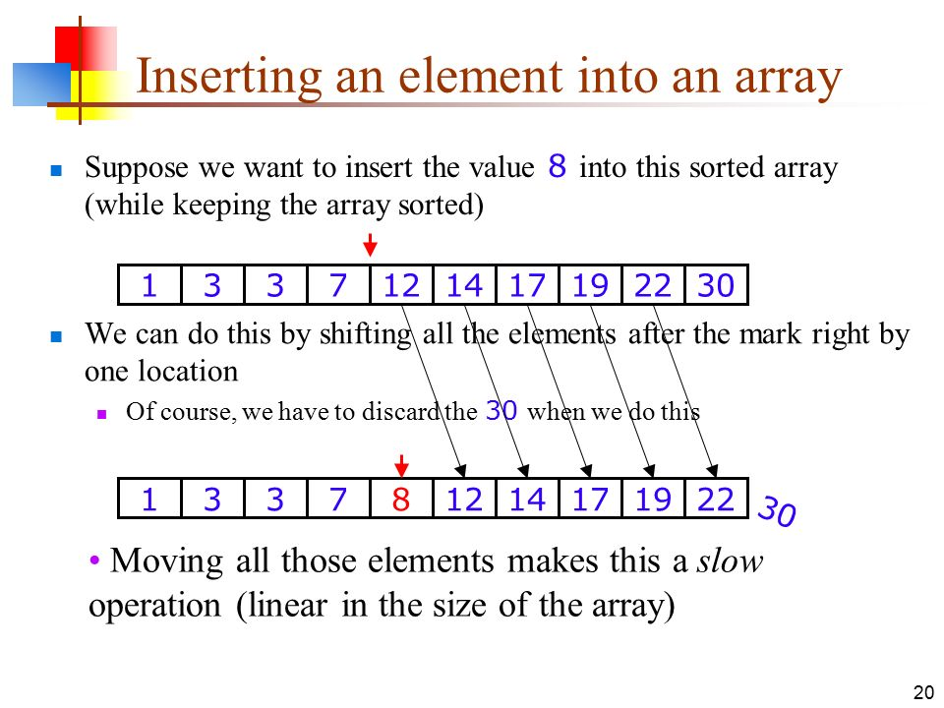

Slide 12
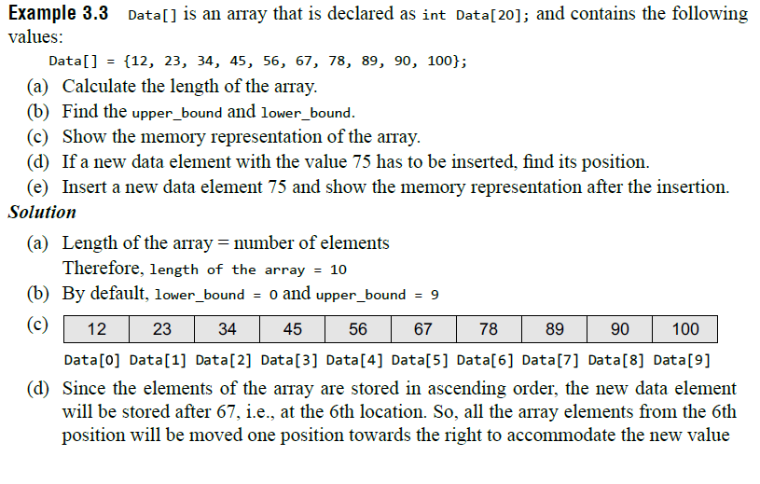
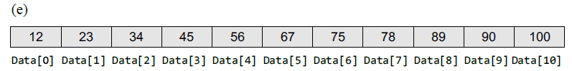

Slide 13
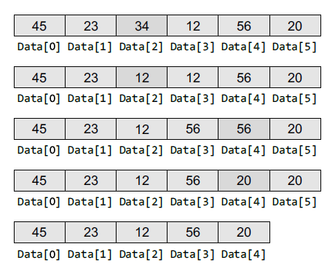
Algorithm to delete the last element of
an array
Step 1: SET upper_bound = upper_bound - 1
Step 2: EXIT
Algorithm to delete an element from the middle of an array
The algorithm DELETE will be declared as DELETE(A, N, POS). The arguments are:
(a) A, the array from which the element has to bedeleted
(b) N, the number of elements in the array
(c) POS, the position from which the element has to be deleted
Step 1: [INITIALIZATION] SET I = POS
Step 2: Repeat Steps 3 and 4 while I <= N – 1
Step 3: SET A[I] = A[I + 1]
Step 4: SET I = I + 1
[END OF LOOP]
Step 5: SET N = N – 1
Step 6: EXIT

Slide 14

Data[] is an array that is declared as int Data[10]; and contains the following values:
Data[] = {12, 23, 34, 45, 56, 67, 78, 89, 90, 100};
(a) If a data element with value 56 has to be deleted, find its position.
(b) Delete the data element 56 and show the memory representation after the deletion.
Solution
(a) Since the elements of the array are stored in ascending order, we will compare the value that has to be deleted with the value of every element in the array. As soon as VAL = Data[I], where I is the index or subscript of the array, we will get the position from which the element has to be deleted. For example, if we see this array, here VAL = 56. Data[0] = 12 which is not equal to 56. We will continue to compare and finally get the value of POS = 4.

Slide 15
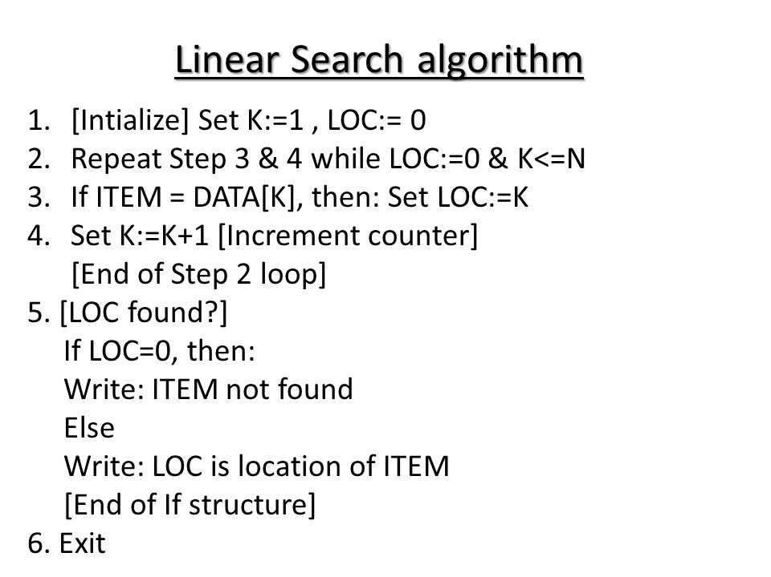

Slide 16
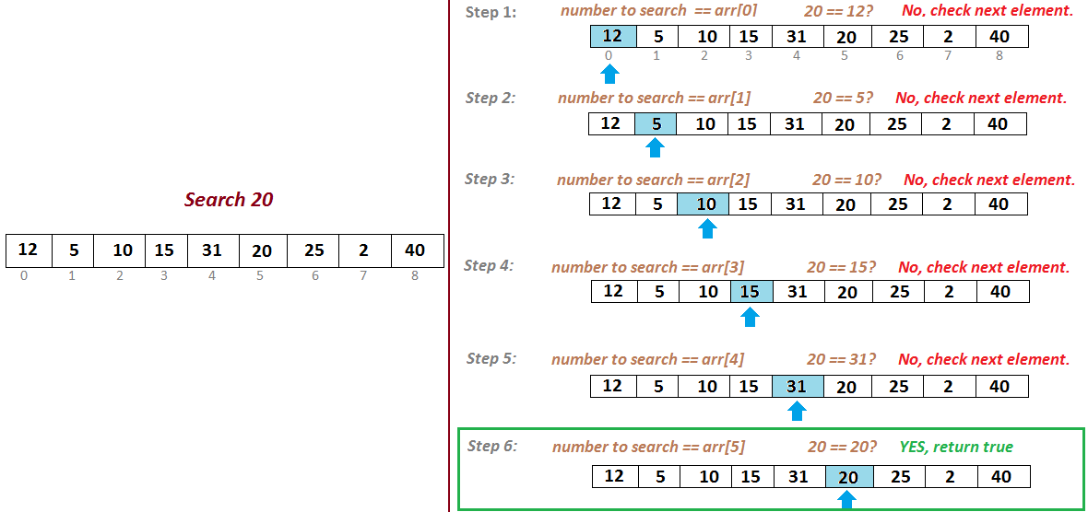

Slide 17
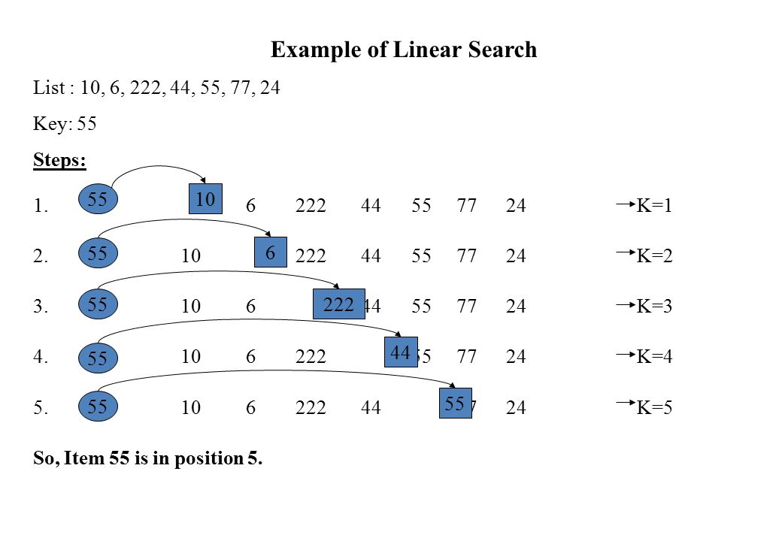

Slide 18
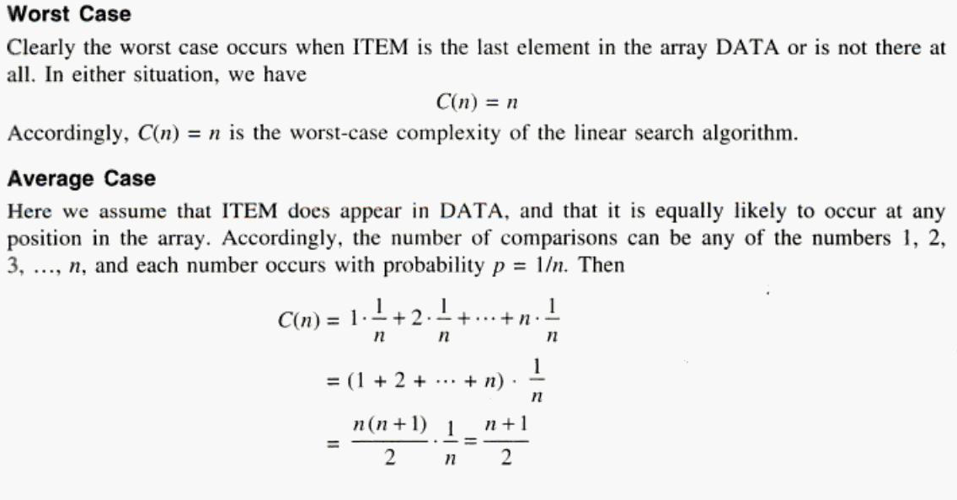

Slide 19
Advantages and Disadvantages of linear search
Advantages
Easy to understand and simple
Does not require a sorted array
Handy and practical approach when the list to be searched has only a few elements.
Disadvantages:
Slow and time consuming
A major disadvantage of using linear search is that it looks down a list, one item at a time, without jumping any element.

Slide 20
Binary Search
Binary search is a searching algorithm that works efficiently with a sorted list.
This search algorithm works on the principle of divide and conquer. For this algorithm to work properly, the data collection should be in the sorted form.
Binary search can be used only with list of element which are already arranged in a order. The binary search can not be used for list of element which are in random order.
This search process starts comparing of the search element with the middle element in the list. If both are matched, then the result is "element found".

Slide 21
Otherwise, we check whether the search element is smaller or larger than the middle element in the list. If the search element is smaller, then we repeat the same process for left sublist of the middle element. If the search element is larger, then we repeat the same process for right sublist of the middle element. We repeat this process until we find the search element in the list or until we left with a sublist of only one element. And if that element also doesn't match with the search element, then the result is "Element not found in the list".

Slide 22
Step 1: [INITIALIZE] SET BEG = lower_bound , END = upper_bound, MID= INT ((BEG+END)/2).
Step 2: Repeat Steps 3 and 4 while BEG <= END and DATA [MID] not equal VAL
Step 3: SET MID = (BEG + END)/2
Step 4: IF A[MID] = VAL PRINT VAL Go to Step 7
ELSE IF A[MID] > VAL
SET END = MID - 1
ELSE
SET BEG = MID + 1
[END OF IF]

Slide 23
Step 5: set MID= INT((BEG + END)/2)
[END OF LOOP]
Step 6: IF DATA[MID]= VAL
SET LOC=MID
ELSE
SET LOC=NULL
[END OF IF]
Step 7: EXIT

Slide 24
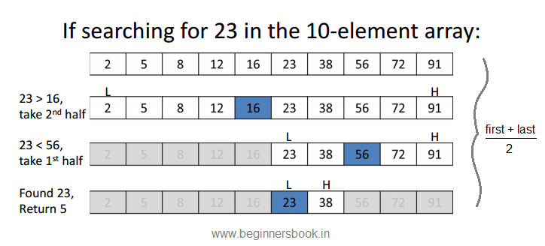

Slide 25
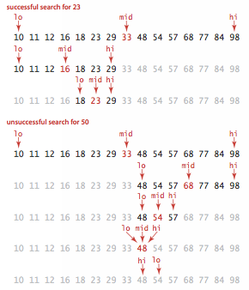

Slide 26
Given a list of numbers a[] = {1, 3, 5, 7, 9, 11, 13, 15, 17, 19, 21}. Search
for value 19 using
Linear search
Binary search technique.

Slide 27
Complexity of Binary Search Algorithm
best case is when the key is equal to the first element compared from the list, in which case only one comparison is needed.
The worst case occurs when the key is present in the list but at such a position/ index that it requires more comparisons to find it.
Another possible worst case is when the value is not present in the list.

Slide 28
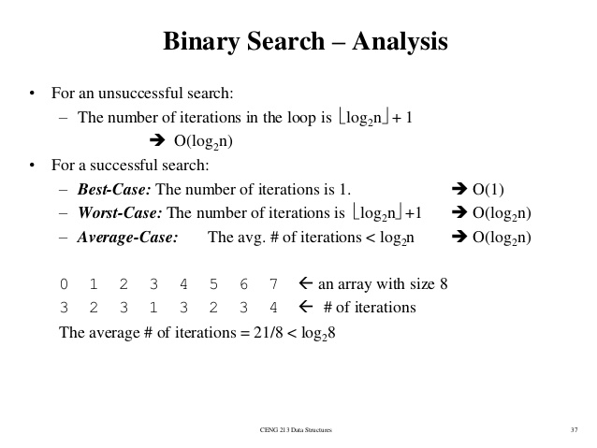

Slide 29
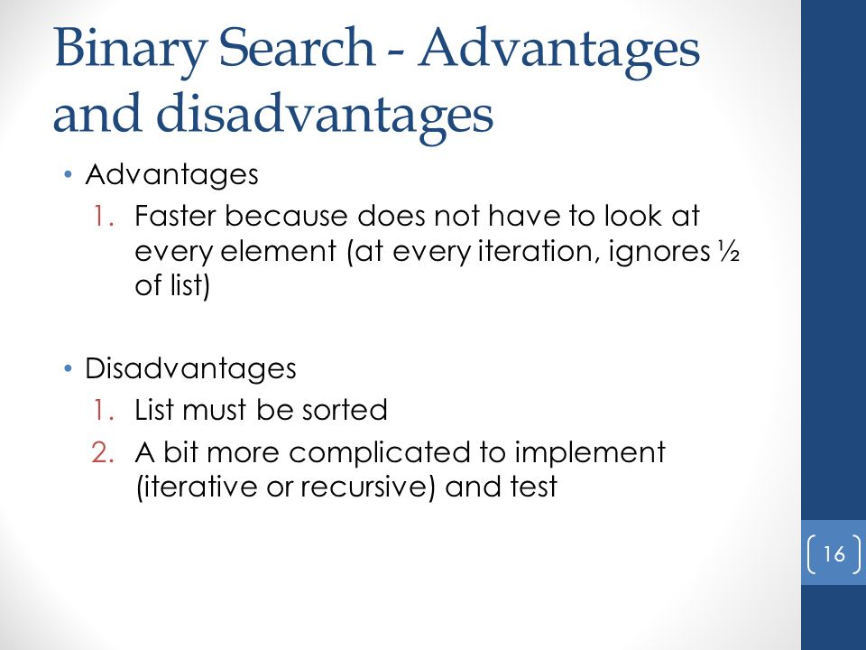

Slide 30
Two Dimensional Array
An array of arrays is known as 2D array.
The two dimensional (2D) array is also known as matrix. A matrix can be represented as a table of rows and columns.
Implementing a database of information as a collection of arrays can be inconvenient when we have to pass many arrays to utility functions to process the database. It would be nice to have a single data structure which can hold all the information, and pass it all at once.
The data associated with certain systems (a digital image, a board game, etc.) lives in two dimensions.

Slide 31
How do we declare a 2D array?
Similar to the 1D array, we must specify the data type, the name, and the size of the array. But the size of the array is described as the number of rows and number of columns.
E.G:
Int a[rows][cols];

Slide 32
Access data in a 2D array:
Like 1D arrays, we can access individual cells in a 2D array by using subscripting expressions giving the indexes, only now we have two indexes for a cell: its row index and its column index. The expressions look like:
A[i][j]=0;
We can initialize all elements of an array to 0 like:
for(i = 0; i < MAX_ROWS; i++)
for(j = 0; j < MAX_COLS; j++)
a[i][j] = 0;

Slide 33
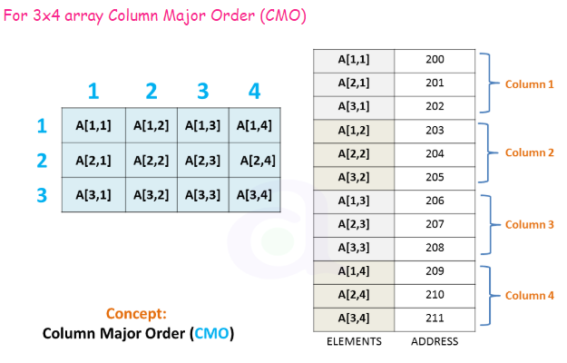
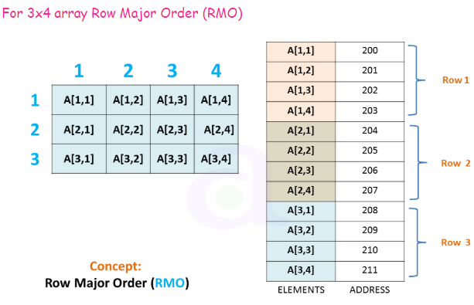
Representation of two-dimensional array in memory
The programming language will store the array A either,
1. column by column is called column major order or
2. Row by row, in row major order

Slide 34
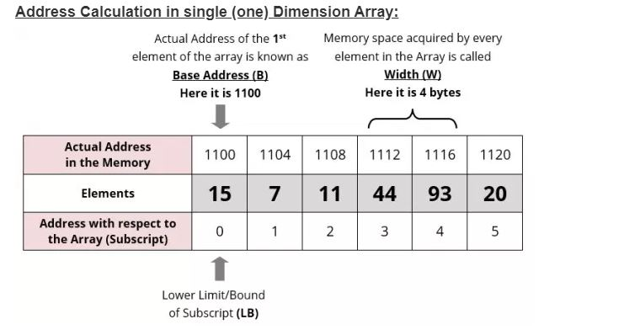

Slide 35
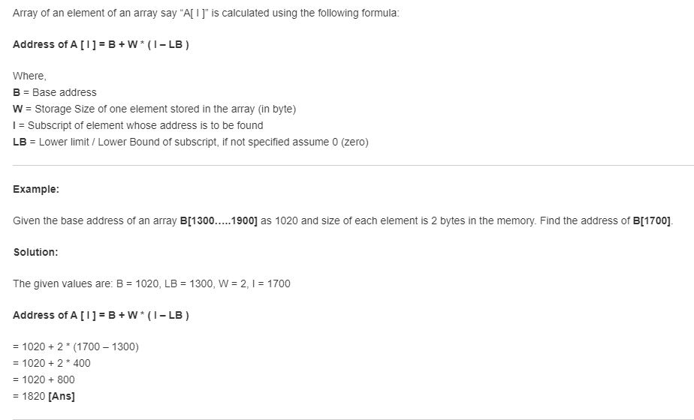

Slide 36
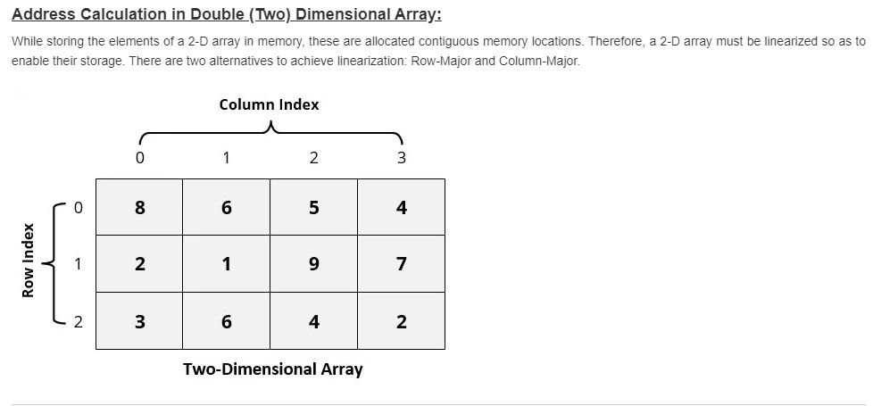

Slide 37
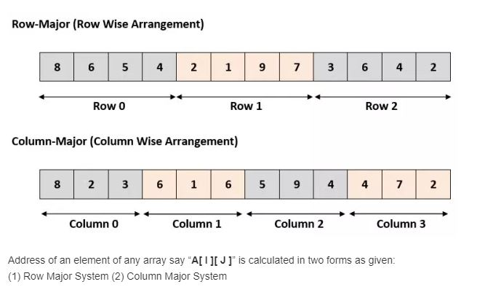

Slide 38
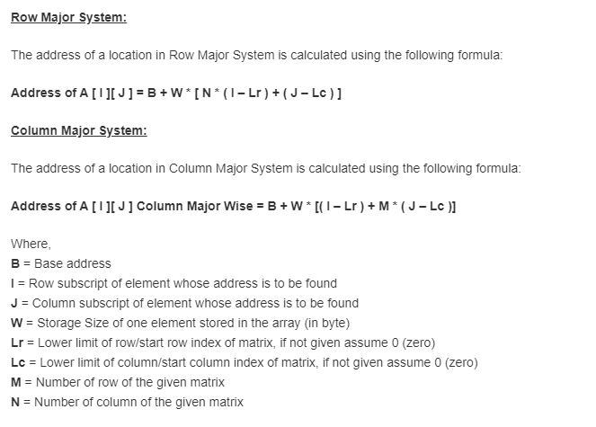

Slide 39
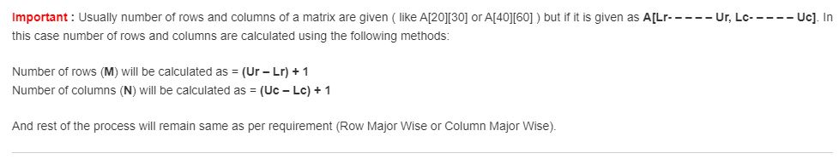

Slide 40
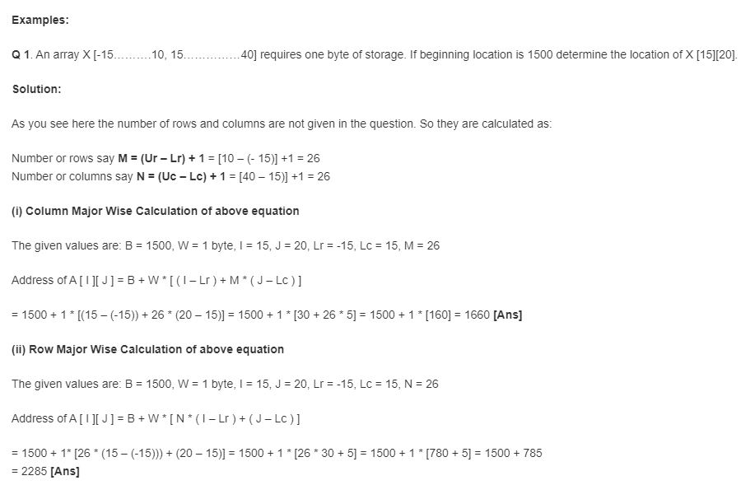

Slide 41
OPERATIONS ON TWO-DIMENSIONAL ARRAYS
Two-dimensional arrays can be used to implement the mathematical concept of matrices. In
mathematics, a matrix is a grid of numbers, arranged in rows and columns. Thus, using two dimensional
arrays, we can perform the following operations on an m×n matrix:
Transpose Transpose of an m \ n matrix A is given as a n \ m matrix B, where Bi,j = Aj,i.
Sum Two matrices that are compatible with each other can be added together, storing the result
in the third matrix. Two matrices are said to be compatible when they have the same number of
rows and columns. The elements of two matrices can be added by writing:
Ci,j = Ai,j + Bi,j
3. Difference Two matrices that are compatible with each other can be subtracted, storing the result
in the third matrix. Two matrices are said to be compatible when they have the same number of
rows and columns. The elements of two matrices can be subtracted by writing:
Ci,j = Ai,j – Bi,j
4. Product Two matrices can be multiplied with each other if the number of columns in the first
matrix is equal to the number of rows in the second matrix. Therefore, m \ n matrix A can be
multiplied with a p \ q matrix B if n=p. The dimension of the product matrix is m \ q. The elements
of two matrices can be multiplied by writing:
Ci,j = S Ai,kBk,j for k = 1 to n

